Slide 1


What is a Command Bus?
Brian Korzynski

Slide 2
About Me
Machine Learning Architect
Professional Developer for 10+ years
Windows Forms
Web
Mobile
SQL Optimization
Data Analysis
Mathematics
Big Data
Cloud
Machine Learning

Slide 3
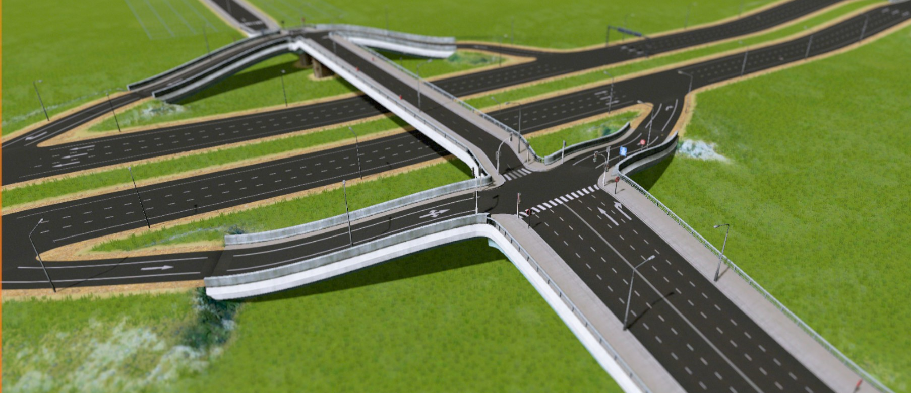
What is a bus?
Notes:
https://steamcommunity.com/sharedfiles/filedetails/?id=522776740

Slide 4
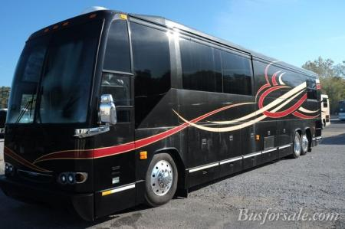

Kinds of Busses
Notes:
tour bus
https://www.google.com/imgres?imgurl=https%3A%2F%2Fwww.busforsale.com%2Fbuses%2Fphotos%2Fmarlin%2Fthumb%2Fthumb_marlinext4.jpg&imgrefurl=https%3A%2F%2Fwww.busforsale.com%2Fbuses%2F&docid=NIU8_flpBWz1fM&tbnid=C0kZ2itbgFS4nM%3A&vet=10ahUKEwjwovmY8ePfAhWGk1kKHTIqAooQMwhoKAEwAQ..i&w=450&h=299&bih=843&biw=1440&q=tour%20bus&ved=0ahUKEwjwovmY8ePfAhWGk1kKHTIqAooQMwhoKAEwAQ&iact=mrc&uact=8
short bus
https://www.reddit.com/r/funny/comments/hvtgu/the_short_bus/

Slide 5
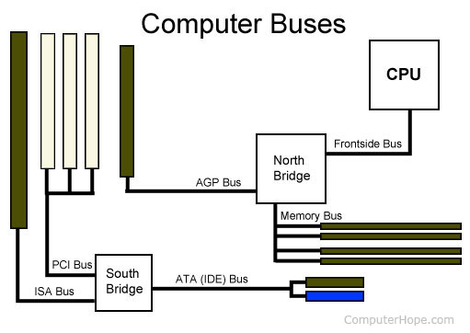
Kinds of Busses: The Computer Bus
Notes:
https://www.computerhope.com/jargon/b/computer-bus.jpg

Slide 6
INTER-COMMUNICATION BUSES
Different apps communicating

Slide 7
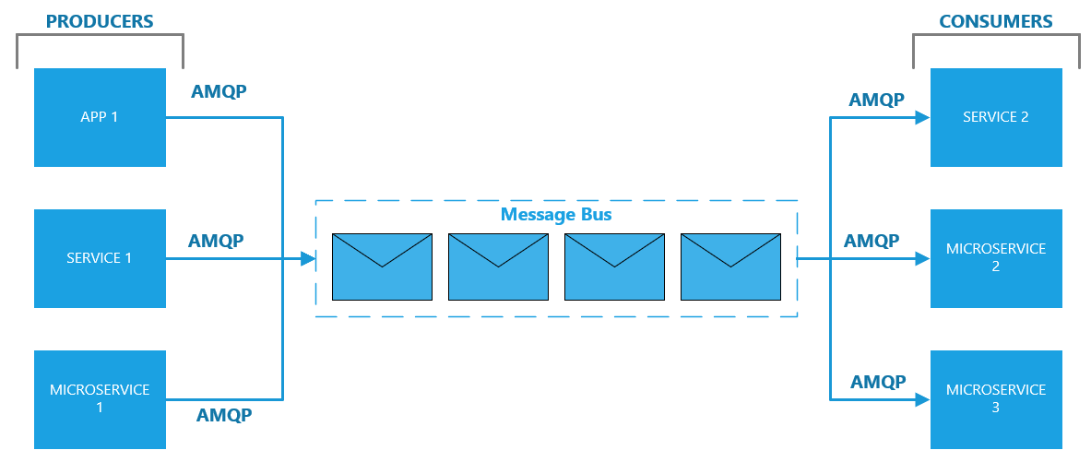
Kinds of Busses: The Message Bus

Slide 8
Message Bus Platforms
Microsoft Azure Service Bus
Rabbit MQ /CloudAMQP (hosted Rabbit MQ)
Amazon Simple Queuing Service (SQS)

Slide 9
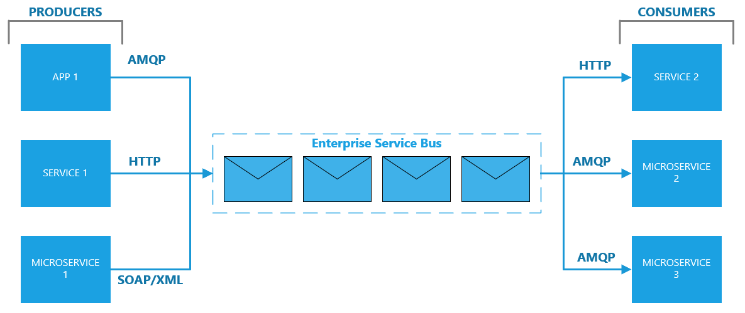
Kinds of Busses: The Enterprise Service Bus (ESB)

Slide 10
Enterprise Service Bus Platforms
MuleSoft
Neuron ESB
NServiceBus

Slide 11
INTRA-COMMUNICATION BUS
Different parts of apps communicating within the same app

Slide 12
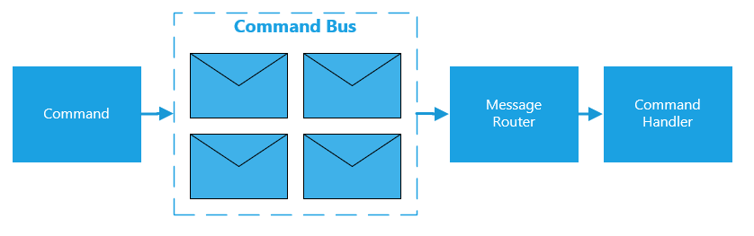
Kinds of Busses: The Command Bus

Slide 13
LET’S BUILD ONE

Slide 14
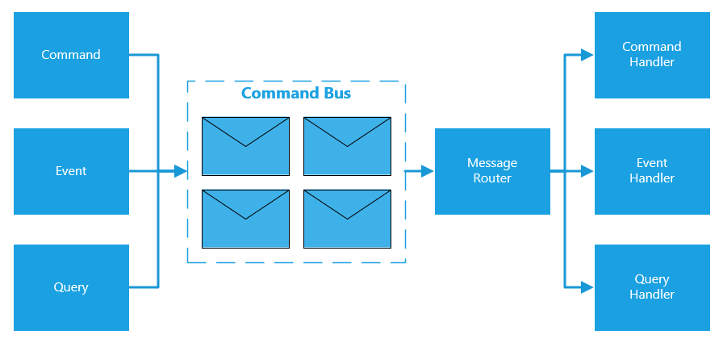
Kinds of Busses: The Typical Command Bus

Slide 15
Pattern: Command
An operation that effects some change to the system (for example, setting a variable). An operation that intentionally creates a side effect. – DDD book
In object-oriented programming, the command pattern is a behavioral design pattern in which an object is used to encapsulate all information needed to perform an action or trigger an event at a later time. This information includes the method name, the object that owns the method and values for the method parameters. – Wikipedia

Slide 16
Pattern: Command-Query Separation
Command–query separation (CQS) is a principle of imperative computer programming. It was devised by Bertrand Meyer as part of his pioneering work on the Eiffel programming language.
It states that every method should either be a command that performs an action, or a query that returns data to the caller, but not both. In other words, Asking a question should not change the answer.[1] More formally, methods should return a value only if they are referentially transparent and hence possess no side effects. -Wikipedia

Slide 17
Pattern: Command Query Responsibility Segregation
Command–query separation (CQS) is a pattern in which you use different model to update information than the model you use to read information.
Why?
Use different technology to modify data than you use to read data
Speed

Slide 18

Pattern: Command Query Responsibility Segregation

Slide 19
DEMO

Slide 20
Frameworks
MediatR
EventFlow
WE ARE GOING TO LOOK AT MediatR

Slide 21
Pro Tips
Make sure you still follow the single responsibility principle
Handlers are not “God” classes
Handlers are typically a one to one with a command
If you have some long running processes, then you might want to use something like DataFlows (TPL) to queue things up
Develop and follow your own naming conventions e.g. actionObjectCommand e.g. InactivateCustomerCommand
I would advise adding a reference to the command bus inside your handlers when you need it

Slide 22
Questions
github.com/korz
@bkorzynski

